Slide 1


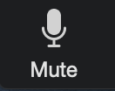
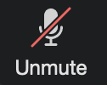

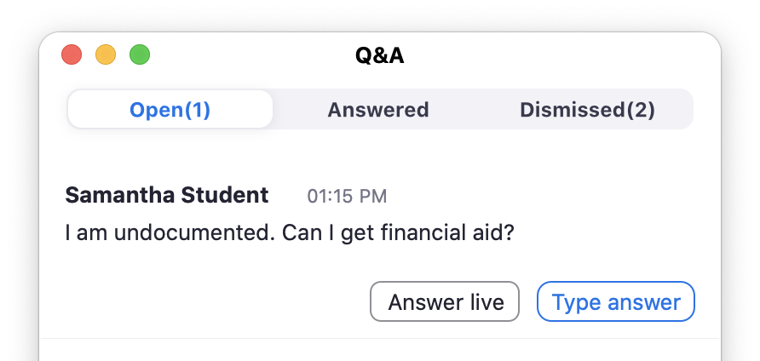


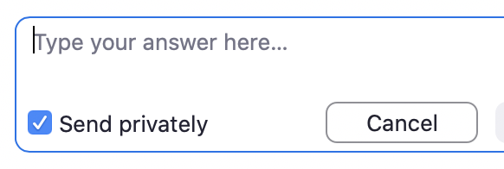
Welcome Panelists!
Reminders
The session ends promptly after 45 minutes
The session is being recorded
Mute yourself while not actively speaking:
Use this button to share your screen:
Are you playing a video? Turn ON this option when sharing your screen:
StriveScan will send your list of registered students and transcript of Q&A within a week
Questions for StriveScan: help@strivescan.com
This session ends after 45 minutes
so the next session can begin. Please be considerate of your time.
Answering Student Questions
Students type questions using the Q&A button:
Don’t press Answer Live:
That will share the student’s name and question with the entire audience, so just repeat the question aloud.
Use the X Dismiss button to hide answered questions.
You can use the [Type Answer] button,
but check Send Privately
You may not get to every question. That’s ok!
You will receive a transcript of all questions submitted for you to follow up with after.
🚫
Notes:
Reminder:
Turn OFF Raise Hand from the Participants > More menu.
Facilitator script:
(Share this slide with the panelist.)
Welcome panelists, thank you for participating!
We’ll start broadcasting the session right at the top of the hour.
I’ll begin with an opening slide and a few housekeeping announcements.
Then I’ll stop sharing my screen, turn off my video, and turn it over to you.
We’ll end the session 45 minutes past the hour.
I’ll turn my video back on and share a final housekeeping slide.
We’ll record the presentation and make it available for those students who couldn’t attend to watch it on-demand later.
Just a reminder to mute yourself when you’re not actively speaking.
StriveScan will send you the list all students registered for this session and a transcript of all of the questions in the Q&A within a week.
Students will ask their questions via the Q&A.
You can go ahead and click the “Q&A” button now to open the window.
We recommend you do not click the “Answer Live” button. That will share the student’s full name and question with the entire audience. Instead, we recommend you simply repeat the question aloud for the entire audience and answer it verbally.
Then you can click the “Dismiss” button to hide the question.
You can also type your responses by clicking the “Type Answer” button, but we also recommend you check the “Send privately” button.
You may not get to every question, that’s ok! You’ll receive a transcript of all of the questions submitted from StriveScan to follow up with students later.
If you get a lot of questions, you might want to acknowledge
Are you sharing your screen? I recommend you go ahead and try sharing your screen now and test it out. (Any panelist can start sharing and override the current share.)
Heads up for the end of the session: When the session is done, I’ll end the webinar. That will disconnect all of us, so we won’t be able to chat afterward, so I just want to say “thank you” in advance.
Share the next slide.
Start webinar.

Slide 2



Virtual College Exploration
for all Virginia students
💬 How do I ask questions?
Use the Q&A button to type your questions
to the presenters at any time:
📅 Sign up for more sessions
This is one of many college presentations offered.
Check out the schedule: www.StriveScan.com/Virginia
📷 Your camera & microphone are OFF
You are muted and your video is off.
The panelists can’t see or hear you.
📺 Recording will be available
All sessions are being recorded and will be available at: www.StriveScan.com/Virginia
🚫
powered by
Notes:
Facilitator’s welcome:
(share this screen)
(Start Webinar)
Welcome to the Virtual College Exploration for all [Virginia] students, sponsored by the Virginia Association of Collegiate Registrars and Admissions Counselors and StriveScan.
Thank you for joining us.
A few housekeeping announcements before we get started:
You can use the Q&A button on your screen to type your questions to our presenters at any time.
Your camera and microphone are off, so the panelists cannot see or hear you.
This is just one of many different session happening, so be sure to check out the full schedule at StriveScan.com/Virginia
This presentation is being recorded and will be available within about a week at that same website, StriveScan.com/Virginia
I’d now like to turn it over to our presenters…
(turn off webcam)
(stop sharing screen)

Slide 3

Thank you for joining us!
Virtual College Exploration
👩‍💻 Quick Survey
After you close this window a very quick, 4-question survey will appear.
📅 Sign up for more sessions
Check out the schedule: www.StriveScan.com/Virginia
📺 Recording will be available
All sessions are being recorded and will be available at: www.StriveScan.com/Virginia
powered by
Notes:
Facilitator’s closing remarks:
Thank you for joining us!
When you close this window, there will be a link to a very quick, four-question survey. We’d appreciate any feedback you can provide.
Also, this was just one of many session being hosted, so be sure to sign up for additional session at StriveScan.com/Virginia
In about a week, you’ll be able to find this session’s recording, as well as all of the other session recordings, at StriveScan.com/Virginia
Thank you!
(End webinar)
Thank you, facilitator! Great job!

Slide 5

Virtual College Exploration
for all Virginia students
Facilitator Training
powered by

Slide 6

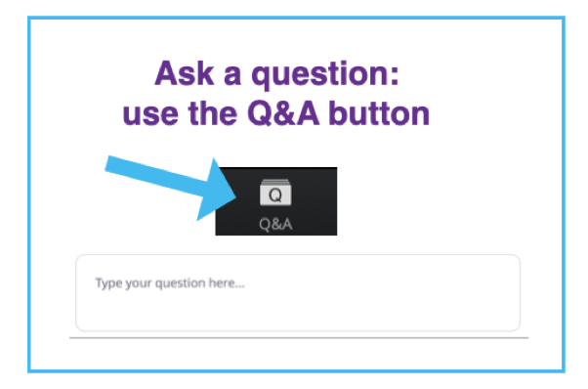
Facilitator Training
Agenda
Overview of the Program
Role of the Facilitator
Zoom Webinars
Getting Started
Q & A
Recording
Before, During and After
Troubleshooting
Housekeeping Slides

Slide 7
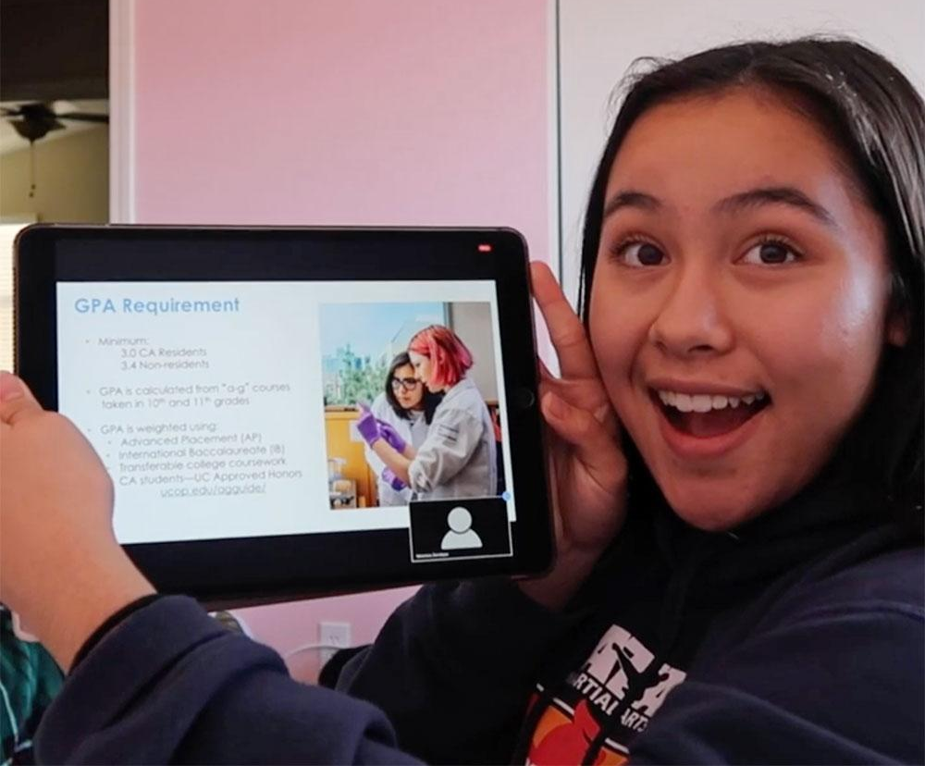
Presenter Training
Virtual College Exploration, for all Virginia students
September 15 - November 2
Various Start Times (11, 12, 1, 2, 3, 4, 5, 6, 7, 8)
Sessions starting every hour on hour
Concurrent sessions each hour
45 minute sessions
Schedule: strivescan.com/virginia
Panel Presentations
63 panel presentations (3 or more colleges)
College knowledge and affinity groups
Giddy Up Schools With Equestrian Opportunities, Public University Price with a Private College Feel, Making The Most of the College Visit, Finding Your Fit, Experience a Women's College, Finding your "fit" as a minority
6x6 College Fairs Weekly
202 institutions presenting
6 Colleges presenting for 6 minutes

Slide 8
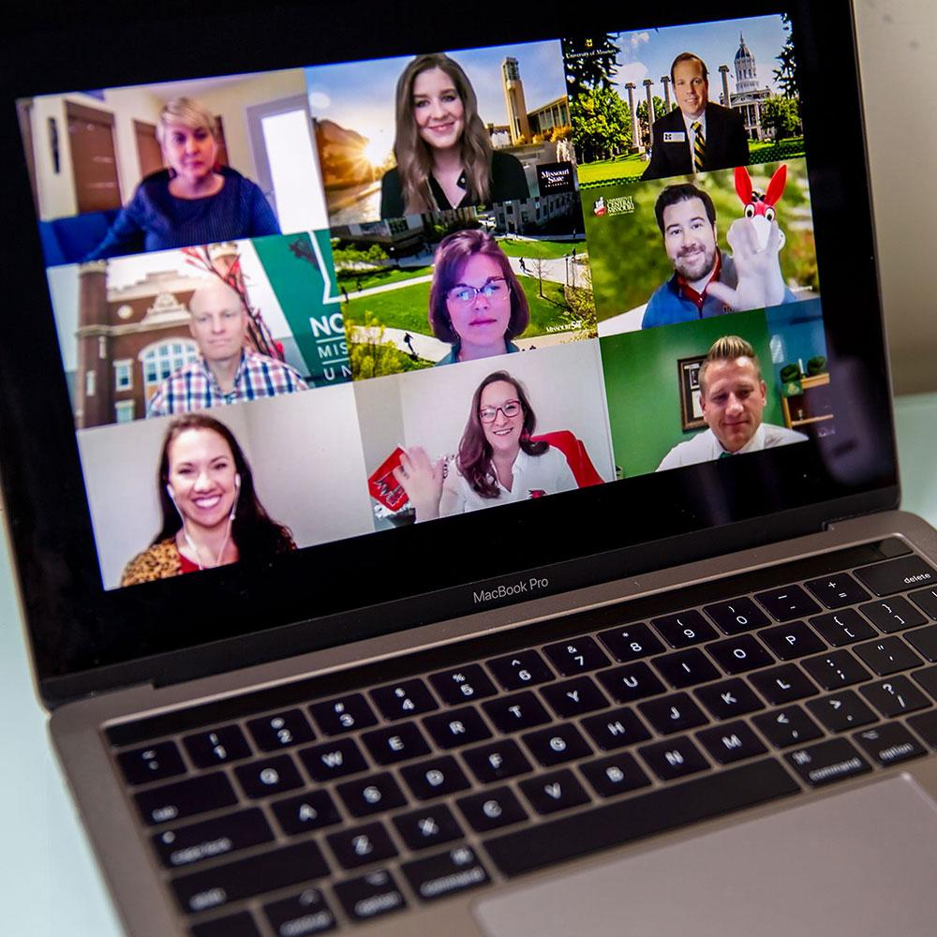
Facilitator Training
Facilitators are crucial!
Ensure the program runs smoothly and on-time
Greet presenters and prepare them
Answer presenter questions
The only person capable of starting the webinar
Provide a consistent intro message to students
Benefits
Support the association!
Help provide opportunities for students and members
Professional development
Scheduling
Fill out the form to volunteer
After you select a spot, if you need to change, please alert VACRAO leadership so they know there’s a vacancy!

Slide 9
Facilitator Training
Zoom Webinars
Zoom Webinars, not Meetings
For security, only the Panelists can turn on their cameras and microphones
Students cannot share their video, screen, or audio
Students interact with reps by typing their questions in the Q&A
Chat is disabled
Logistics
StriveScan’s Zoom accounts are hosting the webinars
Presenters have been invited and receive a unique link to join as panelists
Students and counselors register through StriveScan’s registration form and receive their Zoom attendee link
Role of the Facilitator vs. Panelists
The college representatives have paid for this opportunity to speak with students.
Facilitators are presenters or attendees.
Facilitators do not moderate questions.
While you may have opinions or knowledge on the topic, too, we ask you to refrain from answering student questions or chiming in during the presentation.

Slide 10
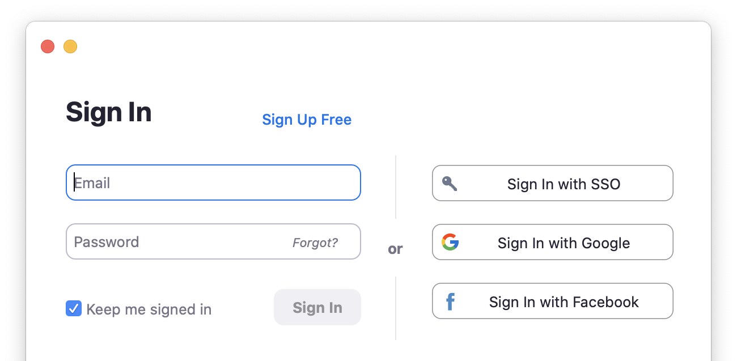
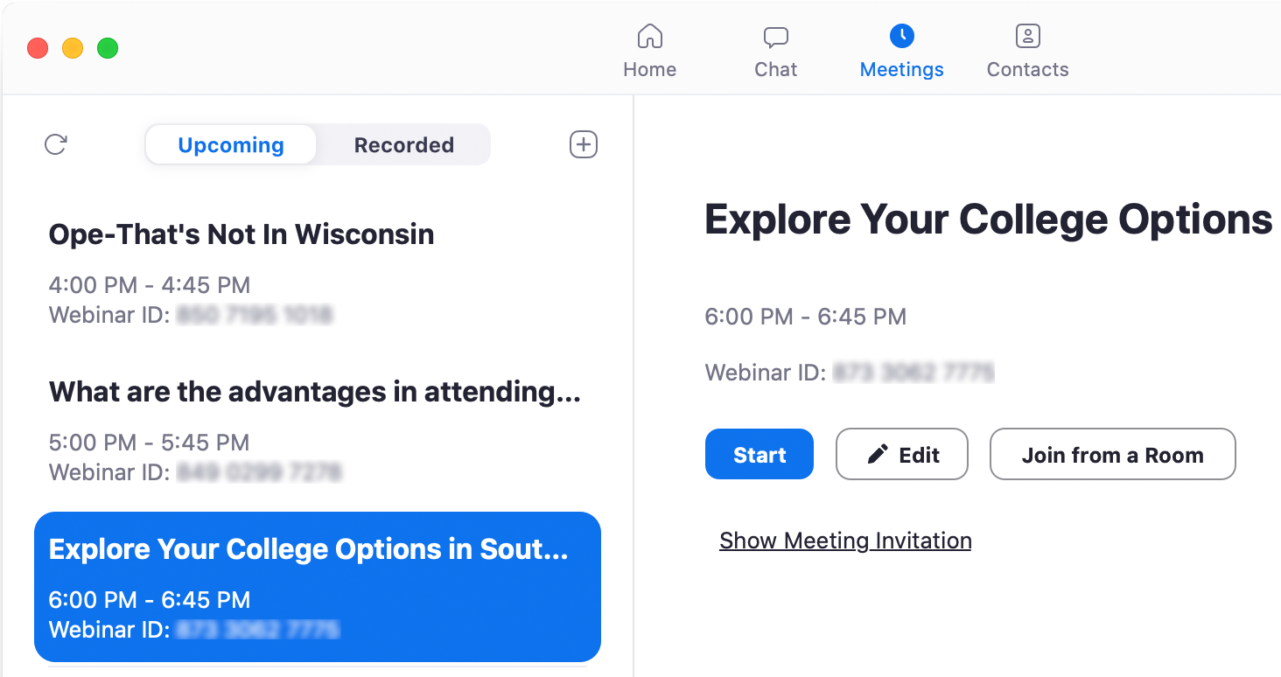
Facilitator Training
Getting Started
Download the Zoom app on your computer
https://zoom.us/download
Already downloaded? Make sure you’re updated to the latest version
Sign into a StriveScan Zoom account
Sign out of your own Zoom account, sign into StriveScan’s
Each session is assigned to a specific Zoom account
After you sign up to facilitate a session, StriveScan will send you the login and password for the session (passwords are changed regularly)
This will be sent every Friday for the following week’s sessions
zoom+XX@strivescan.com
Provided

Slide 11
Facilitator Training
Join the session 10 minutes prior to the start time
Being on-time is crucial; 10 minutes prior to start time
Too early: Another session is still going on
Too late: Don’t keep the presenters waiting
Presenters should be joining 8 minutes prior to the session start time
Before
Before the webinar is broadcasted to students, you and the panelists are in a private Practice Session.
Use this time to run through the Panelist Welcome slides and allow the panelists to discuss any last minute details of their presentation.
Sample schedule:
12:00 - Session 1 starts
12:45 - Session 1 ends
12:50 - Session 2’s facilitator starts Session 2
12:52 - Session 2’s presenters join
1:00 - Session 2 begins
1:45 - Session 2 ends
1:50 - Session 3’s facilitator starts Session 3
Repeat...

Slide 12
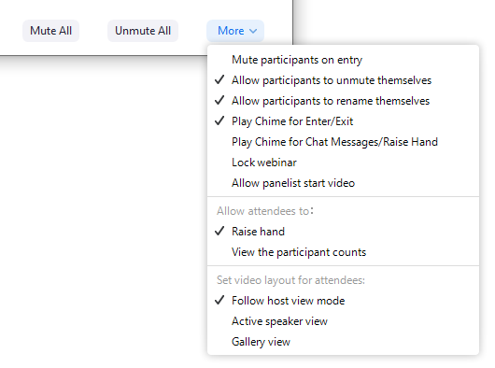
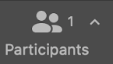
Facilitator Training
Before panelists join:
Uncheck Raise Hand:
Participants > More > uncheck Raise Hand
Open the slides: https://strivefair.com/vacrao-slides
Script is in the Speaker Notes
When panelists join:
Introduce yourself to the panelists as a VACRAO member and volunteer facilitator.
Share the next “Welcome panelists” slide and review the panelist checklist.
Uncheck

Slide 13
Welcome Panelists!
Reminders
The session ends promptly after 45 minutes
The session is being recorded
Mute yourself while not actively speaking:
Use this button to share your screen:
Are you playing a video? Turn ON this option when sharing your screen:
StriveScan will send your list of registered students and transcript of Q&A within a week
Questions for StriveScan: help@strivescan.com
This session ends after 45 minutes
so the next session can begin. Please be considerate of your time.
Answering Student Questions
Students type questions using the Q&A button:
Don’t press Answer Live:
That will share the student’s name and question with the entire audience, so just repeat the question aloud.
Use the X Dismiss button to hide answered questions.
You can use the [Type Answer] button,
but check Send Privately
You may not get to every question. That’s ok!
You will receive a transcript of all questions submitted for you to follow up with after.
🚫
Notes:
Reminder:
Turn OFF Raise Hand from the Participants > More menu.
Facilitator script:
(Share this slide with the panelist.)
Welcome panelists, thank you for participating!
We’ll start broadcasting the session right at the top of the hour.
I’ll begin with an opening slide and a few housekeeping announcements.
Then I’ll stop sharing my screen, turn off my video, and turn it over to you.
We’ll end the session 45 minutes past the hour.
I’ll turn my video back on and share a final housekeeping slide.
We’ll record the presentation and make it available for those students who couldn’t attend to watch it on-demand later.
Just a reminder to mute yourself when you’re not actively speaking.
StriveScan will send you the list all students registered for this session and a transcript of all of the questions in the Q&A within a week.
Students will ask their questions via the Q&A.
You can go ahead and click the “Q&A” button now to open the window.
We recommend you do not click the “Answer Live” button. That will share the student’s full name and question with the entire audience. Instead, we recommend you simply repeat the question aloud for the entire audience and answer it verbally.
Then you can click the “Dismiss” button to hide the question.
You can also type your responses by clicking the “Type Answer” button, but we also recommend you check the “Send privately” button.
You may not get to every question, that’s ok! You’ll receive a transcript of all of the questions submitted from StriveScan to follow up with students later.
If you get a lot of questions, you might want to acknowledge
Are you sharing your screen? I recommend you go ahead and try sharing your screen now and test it out. (Any panelist can start sharing and override the current share.)
Heads up for the end of the session: When the session is done, I’ll end the webinar. That will disconnect all of us, so we won’t be able to chat afterward, so I just want to say “thank you” in advance.
Share the next slide.
Start webinar.

Slide 14

Facilitator Training
Starting the session:
At the top of the hour, to start the session, click the blue Start Webinar button. Begin the announcements.
Recording will begin and end automatically.
Start the announcements right away.
Students will start to flow in during the announcements.
Turn it over to the presenters: Turn off your video and mute your audio.

Slide 15
Virtual College Exploration
for all Virginia students
💬 How do I ask questions?
Use the Q&A button to type your questions
to the presenters at any time:
📅 Sign up for more sessions
This is one of many college presentations offered.
Check out the schedule: www.StriveScan.com/Virginia
📷 Your camera & microphone are OFF
You are muted and your video is off.
The panelists can’t see or hear you.
📺 Recording will be available
All sessions are being recorded and will be available at: www.StriveScan.com/Virginia
🚫
powered by
Notes:
Facilitator’s welcome:
(share this screen)
(Start Webinar)
Welcome to the Virtual College Exploration for all [Virginia] students, sponsored by the Virginia Association of Collegiate Registrars and Admissions Counselors and StriveScan.
Thank you for joining us.
A few housekeeping announcements before we get started:
You can use the Q&A button on your screen to type your questions to our presenters at any time.
Your camera and microphone are off, so the panelists cannot see or hear you.
This is just one of many different session happening, so be sure to check out the full schedule at StriveScan.com/Virginia
This presentation is being recorded and will be available within about a week at that same website, StriveScan.com/Virginia
I’d now like to turn it over to our presenters…
(turn off webcam)
(stop sharing screen)

Slide 16

Facilitator Training

Slide 17

Facilitator Training
Ending the Session
Staying on time
There must be hard stop at 45 minutes for the next session to begin
Gently, but firmy remind presenter of their time limit
45 minutes past the hour, if presenters do not naturally end on their own, turn your video and share the ending Thank You slide (this will override anything currently being shared).
This is usually enough to remind presenters their time is up.
Wrapping up
Make closing announcements
Click End Meeting for All to conclude and disconnect
Sign Out
Sign out of the StriveScan Zoom account.

Slide 18
Thank you for joining us!
Virtual College Exploration
👩‍💻 Quick Survey
After you close this window a very quick, 4-question survey will appear.
📅 Sign up for more sessions
Check out the schedule: www.StriveScan.com/Virginia
📺 Recording will be available
All sessions are being recorded and will be available at: www.StriveScan.com/Virginia
powered by
Notes:
Facilitator’s closing remarks:
Thank you for joining us!
When you close this window, there will be a link to a very quick, four-question survey. We’d appreciate any feedback you can provide.
Also, this was just one of many session being hosted, so be sure to sign up for additional session at www.StriveScan.com/Virginia
In about a week, you’ll be able to find this session’s recording, as well as all of the other session recordings, at www.StriveScan.com/Virginia
Thank you!
(End webinar)
Thank you, facilitator! Great job!

Slide 19
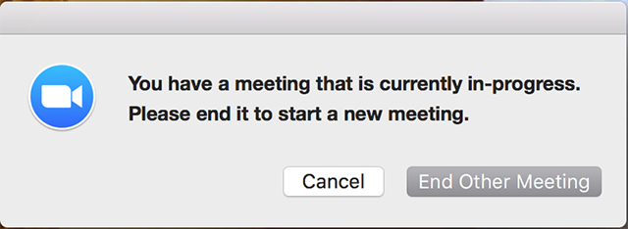
Facilitator Training
Troubleshooting
Error: Another Meeting In-Progress
If you try and enter your session 10 minutes prior to the start time and you get a message that another meeting is in-progress, DO NOT END OTHER MEETING, yet. Press Cancel.
The preceding webinar may be running long.
Try starting again 8 minutes prior.
  If message still appears, then End Other Meeting.
Presenter’s Audio Not Working
Have presenter check their Zoom Settings > Audio.
Virtual Background Not Working
Requires a new-ish computer.

Slide 20
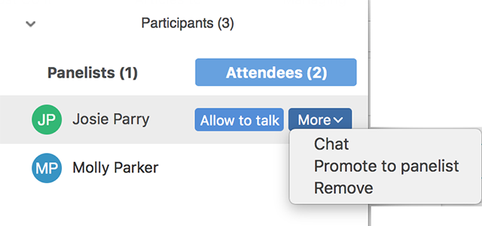
Facilitator Training
Troubleshooting
Disruptive Attendee in the Q&A
Due to our security settings, attendees have limited ways to disrupt the presentation.
  Attendees cannot speak, turn on their video, or share their screens.
  Chat between attendees has been disabled.
While we think it unlikely, we want you to be prepared.
If a student/attendee writes an inappropriate question in the Q&A, “dismiss” the question to hide it.
As long as panelists DO NOT type an answer to the question or click Answer Live, then no other students will see the question. (Only the panelists see the unanswered Q&A.)
Remove the attendee:
  Press the Participants button
  Switch to the Attendees tab
  Find the Attendee’s name from the list
  Click the More menu next to their name
  Select Remove to disconnect the person
Report immediately to help@strivescan.com

Slide 21
Facilitator Training
Troubleshooting
Presenter No Show
It’s unlikely: Presenters are sent reminder emails one day and one hour before their session start time.
If no presenters show up, stay in the Practice Session. Hopefully they’re just running behind.
10 minutes after the session’s start time:
  Start the webinar.
  Announce to the audience:
  “Unfortunately the presenter are unavailable and the session has been canceled.
  We apologize for the inconvenience. ”
  End the webinar.
Notify help@strivescan.com and VACRAO Leadership (email is on the final slide)

Slide 22
Virtual College Exploration
for all Virginia students
help@strivescan.com
Sarah Lindberg: slindber@umw.edu
https://strivefair.com/vacrao-slides
powered by

